Slide 1
The development of coffea schemas
This project is being made by the support of IRIS-HEP program
Speaker: Maxym Naumchyk
Mentors: Ianna Osborne, Iason Krommydas, Nick Smith, Peter Fackeldey (listing order is random)

Slide 2

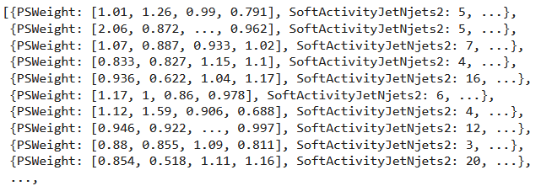

Coffea hands-on example
Root file
TTree structure
Awkward array

Slide 3
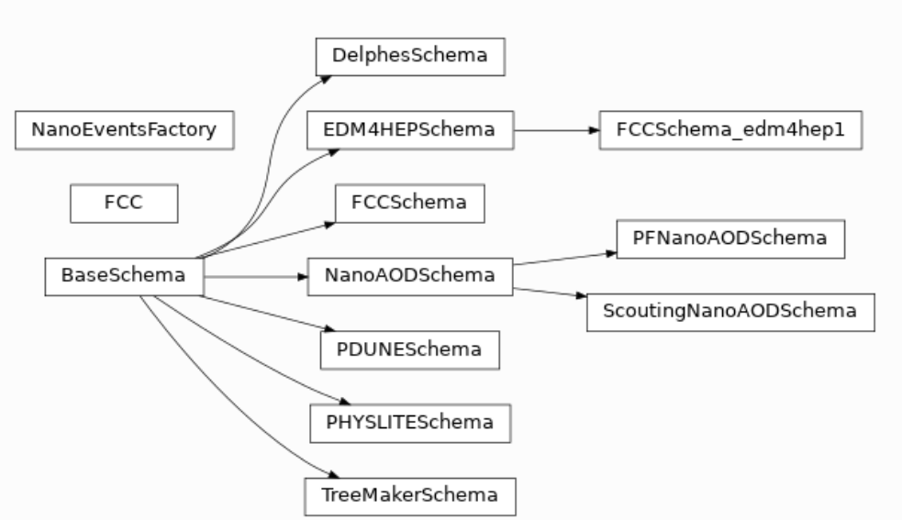
Coffea schemas
Image link: https://coffea-hep.readthedocs.io/en/latest/modules/coffea.nanoevents.html#classes

Slide 4
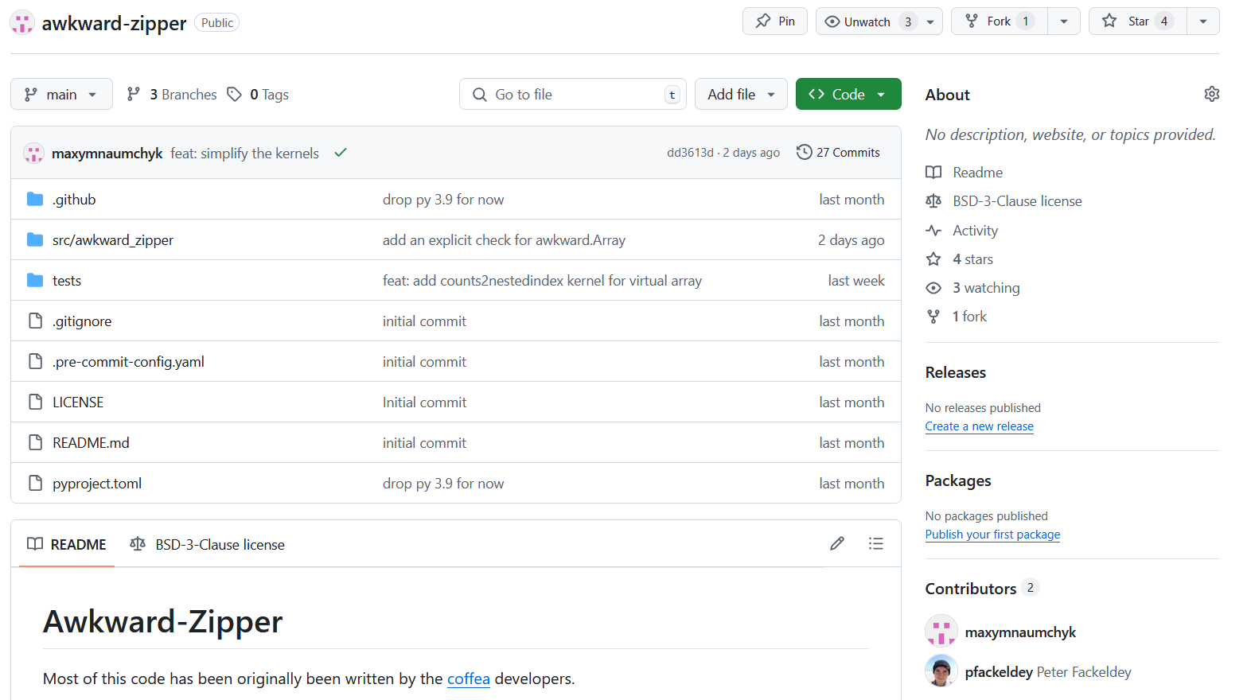
Awkward-zipper
Link: https://github.com/maxymnaumchyk/awkward-zipper

Slide 5
Advantages of a standalone package
Smaller package
Only a few dependencies
Improvements(simplifications) in how the ‘schemas’ work internally (makes it easier for users to create their own ‘schemas’)

Slide 6
Plans of development
Nanoaod format works with eager(materialized) arrays
Nanoaod format works with virtual(not materialized) arrays
Nanoaod format works with dask-awkward
Awkward zipper supports all ‘schemas’ from coffea
I’m currently here ->

Slide 7
Thank you for attention!
Full presentation link: https://github.com/maxymnaumchyk/AGC-Demo-day-2025

